Slide 1






Capstone Project
Alexander Paz Ocampo
October 2021

Slide 2



OUTLINE
Executive Summary
Introduction
Methodology
Results
Visualization – Charts
Dashboard
Discussion
Findings & Implications
Conclusion
Appendix

Slide 3

EXECUTIVE SUMMARY
Space X advertises Falcon 9 rocket launches cost 62 million dollars, while competency cost 100 million more
The objective of this study is determine if by meanings of data science a prediction of the launch outcome is possible
For that, 4 ML models where tested:
Decision Trees, KNNs, SVM and Logistic Regression
After tuning and testing every model, an average accuracy of 83.33% was achieved also a recall of 100%
Nevertheless, the Tree Model had a slightly advantage in the precision score, making it the final selection

Slide 4

INTRODUCTION
Space X advertises Falcon 9 rocket launches on its website with a cost of 62 million dollars; other providers cost upward of 165 million dollars each.
Much of the savings is because Space X can reuse the first stage. Therefore, if we can determine if the first stage will land, we can determine the cost of a launch.
This information can be used if an alternate company wants to bid against space X for a rocket launch.
The objective of this project is creating a machine learning pipeline to predict if the first stage will land given the data from the preceding labs

Slide 5

METHODOLOGY
Collect data and apply Data Weangling
Make Exploratory Data Analysis on the data
Make Visual Exploratory Data Analysis and Dashboard
Realize a predictive analysis
Get insights from the analysis

Slide 6
Data collection/wrangling methodology
Data was obtained by accessing SpaceX API for:
Launches
Payload information
Launch information including outcome
Data then was merged into a coherent dataset for further analysis
Please see the proper slides in the Appendix

Slide 7
EDA and visual analytics methodology
Matplotlib and Seaborn libraries were used to visual explore data from previous described dataset
Exploration was made between:
Flight number and launch site
Payload and launch site
Success rate of each orbit type
Flight number and orbit type
Payload and orbit type
Trend over the years

Slide 8
EDA and visual analytics methodology
Matplotlib and Seaborn libraries were used to visual explore data from previous described dataset
Exploration was made between:
Flight number and launch site
Payload and launch site
Success rate of each orbit type
Flight number and orbit type
Payload and orbit type
Trend over the years
Dash was used to make a dashboard to further explore the data (see slides in the Appendix)

Slide 9
Predictive Analysis Methodology
After scaling and encoding the relevant features from the data, 4 models were tested:
Logarithmic Regression
Decision Tree
KNN
Supported Vector Machine
For each one, a hyperparameter tuning was made by means of a Grid search
4 metrics were used to measure performance:
Accuracy
Precision
Recall
ROC - AUC

Slide 10
RESULTS
From the EDA:
CCAFS LC-40 has the largest successful launches
VAFB SLC-4E and KSC LC-39A have the highest launch success rate (100%)
Payloads above 2000Kg have the highest launch success rate
F9 v1.1 has the highest success rate
From the model evaluation:
* Decision Tree obtained the highest precision score

Slide 11

DASHBOARD
https://alexanderpaz-8050.theiadocker-2-labs-prod-theiak8s-4-tor01.proxy.cognitiveclass.ai/

Slide 12
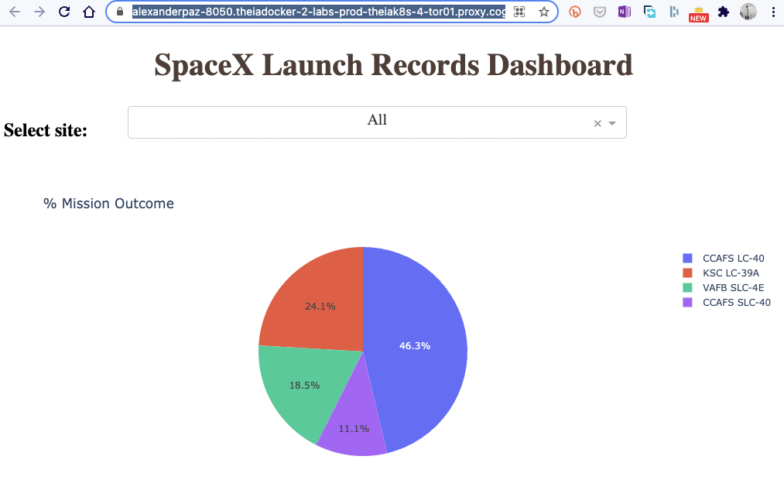
DASHBOARD TAB 1

Slide 13
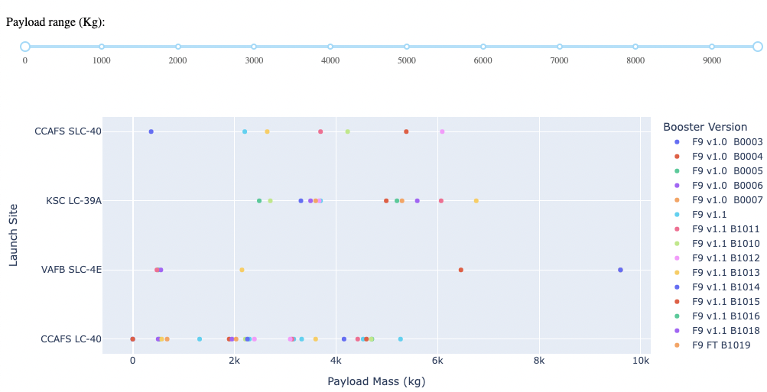
DASHBOARD TAB 2

Slide 14
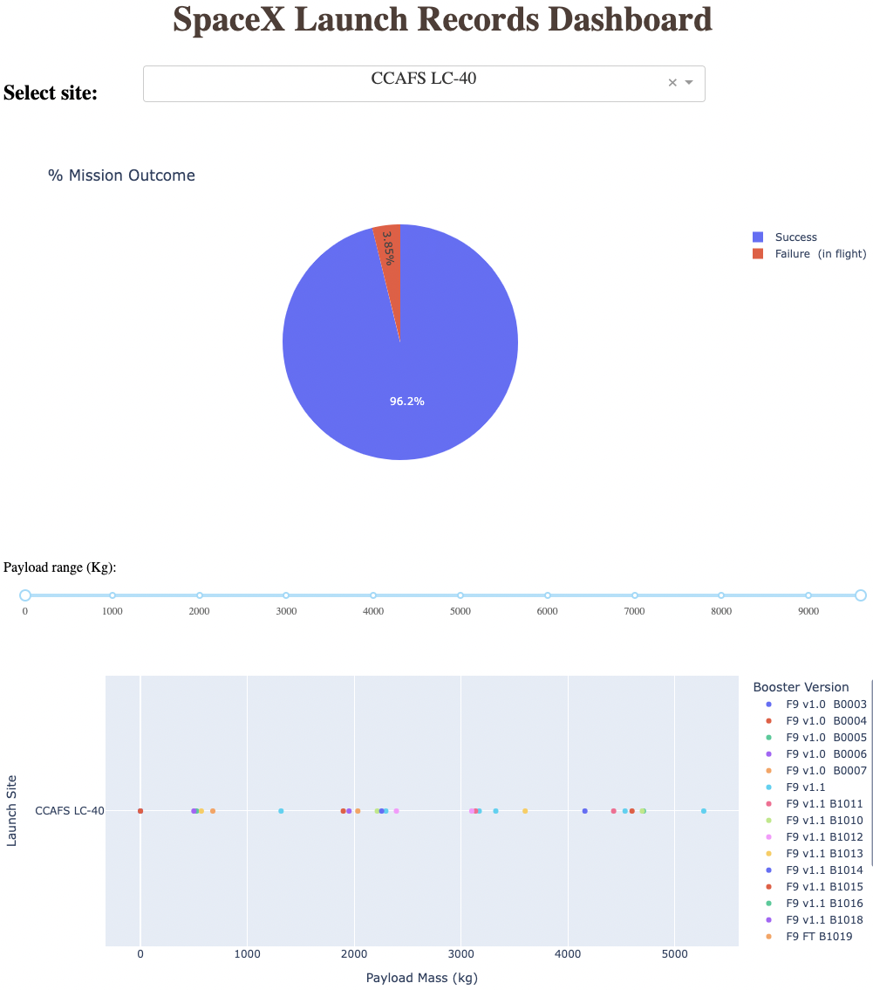
DASHBOARD TAB 3

Slide 15
DISCUSSION
The Exploratory Data Analysis showed that the maturity of the launches in time have a great impact in the outcome.
Also, there are variables that have correlation such as payload mass, launch site and version of the booster

Slide 16

CONCLUSION
There are variables in every launch correlated with the final outcome of the phase 1 landing
It is possible to construct a machine learning model that would predict the outcome of new launches
The best model for the task is the Decision Tree model

Slide 17

APPENDIX

Slide 18
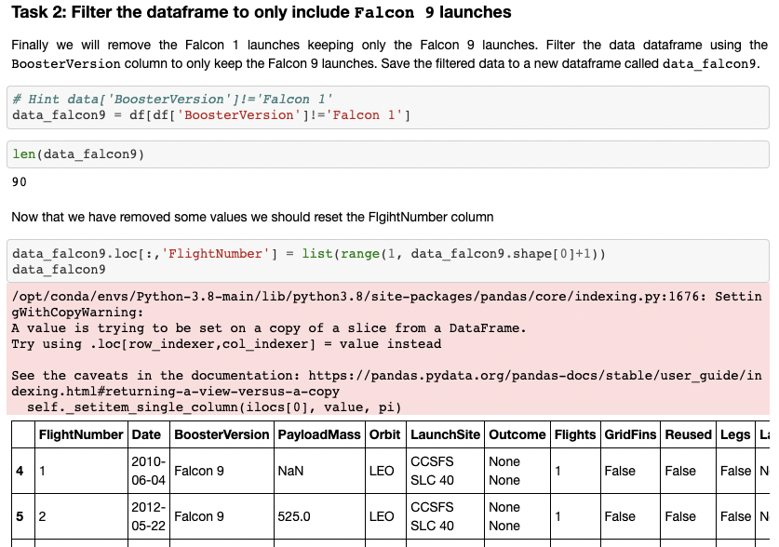
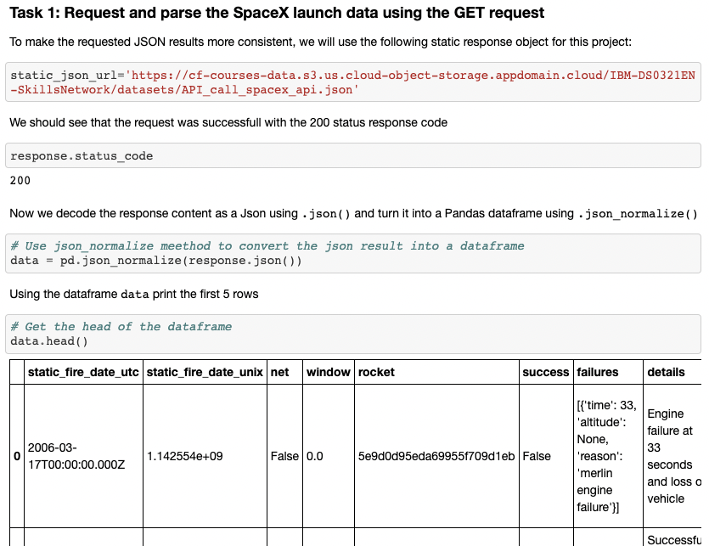
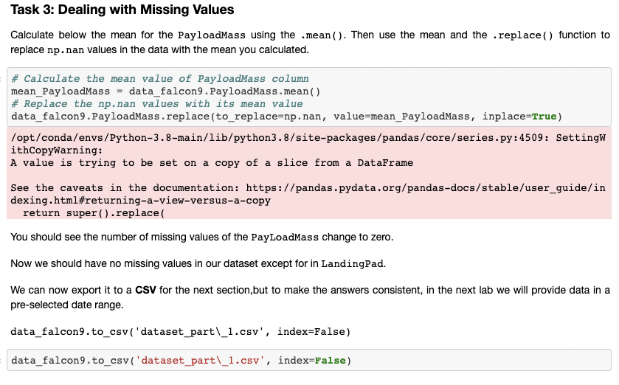
Data collection and data wrangling - here

Slide 19
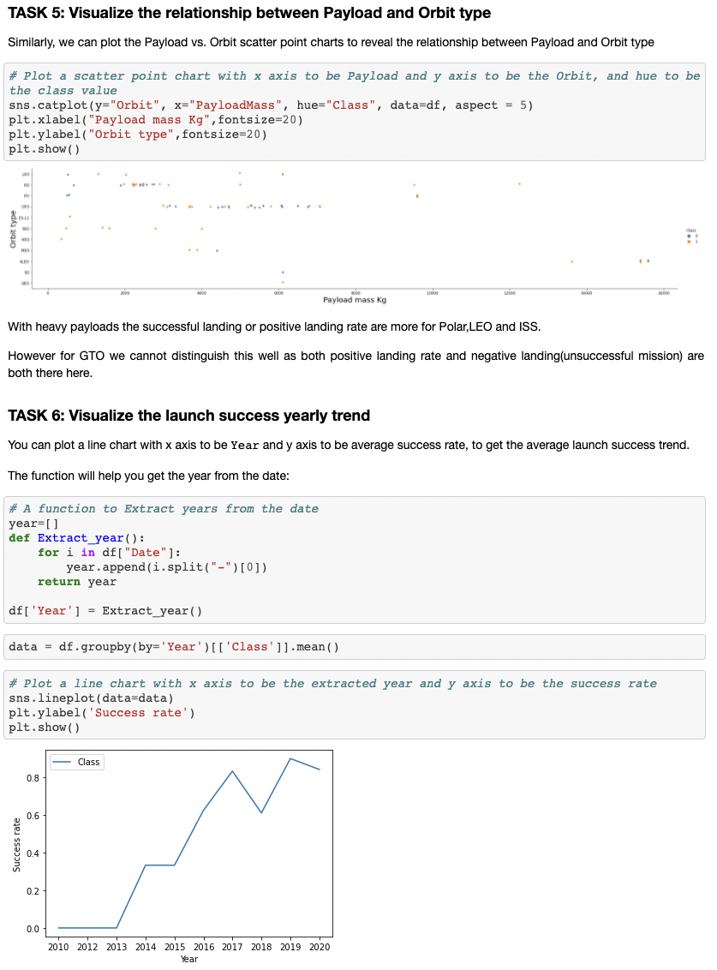
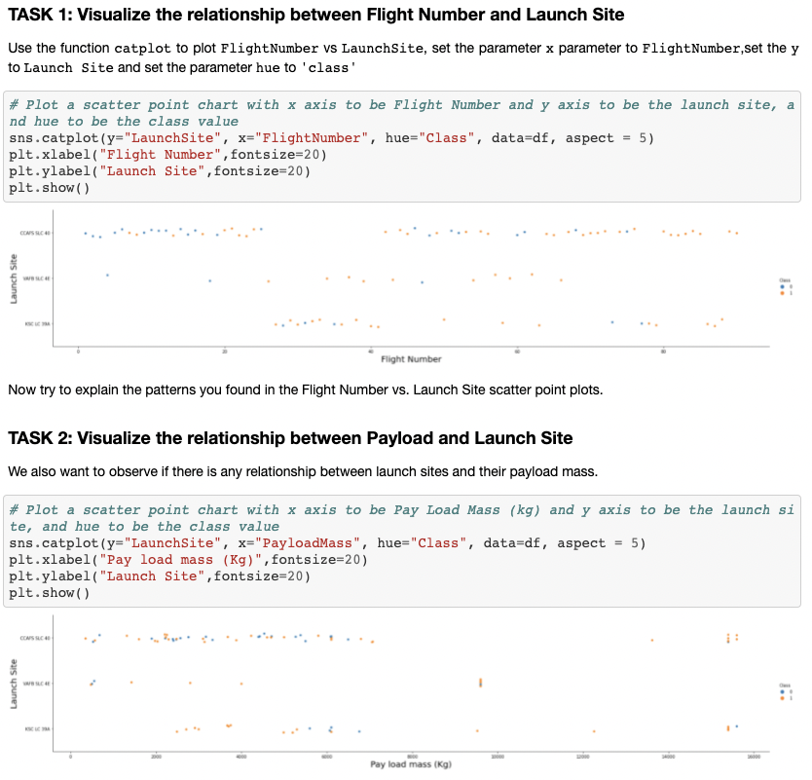
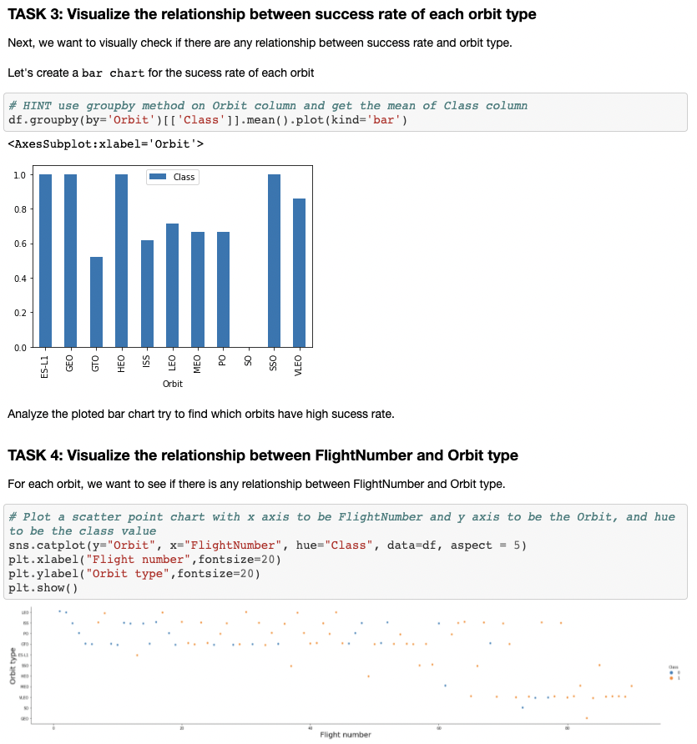
EDA and interactive visual analytics- here

Slide 20
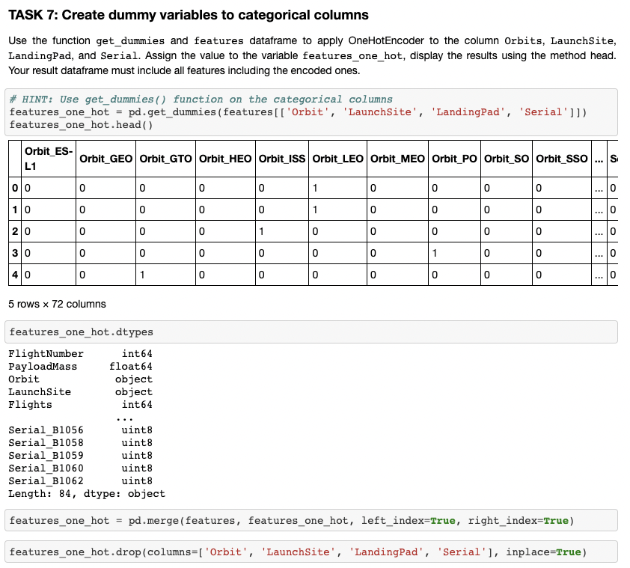
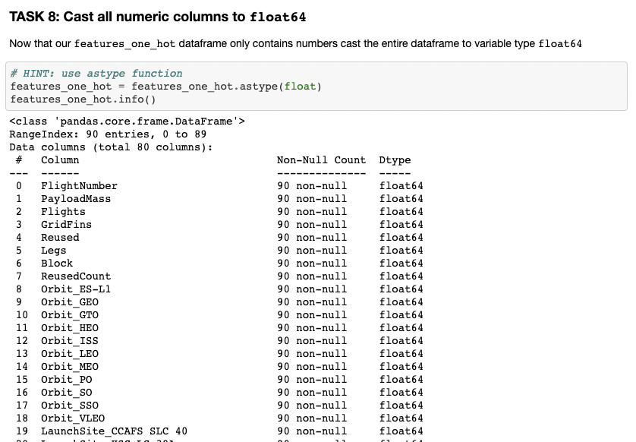
EDA and interactive visual analytics- here

Slide 21
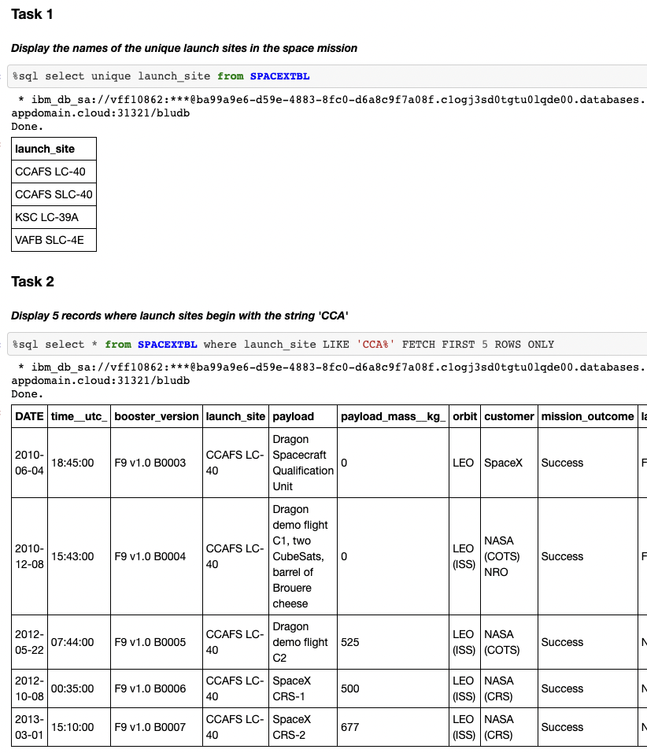
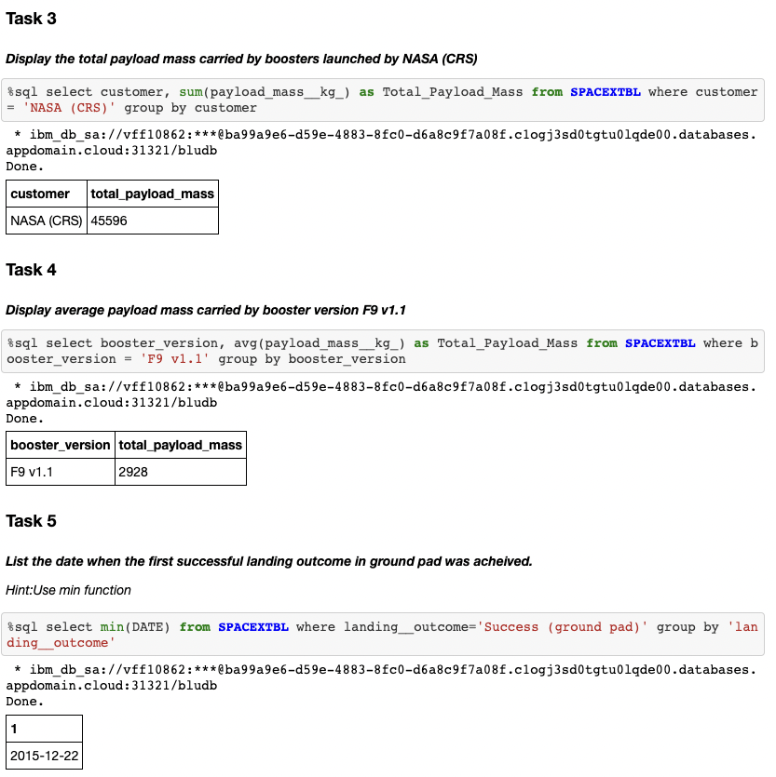
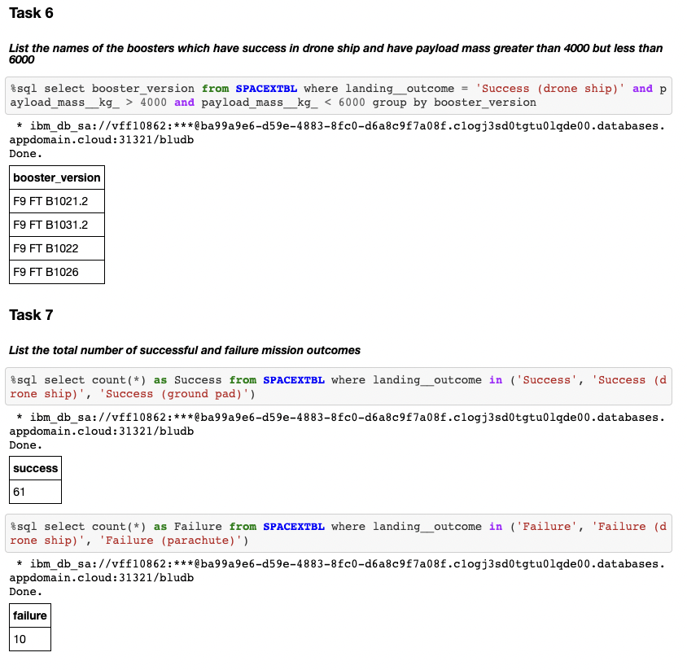
EDA with SQL- here

Slide 22
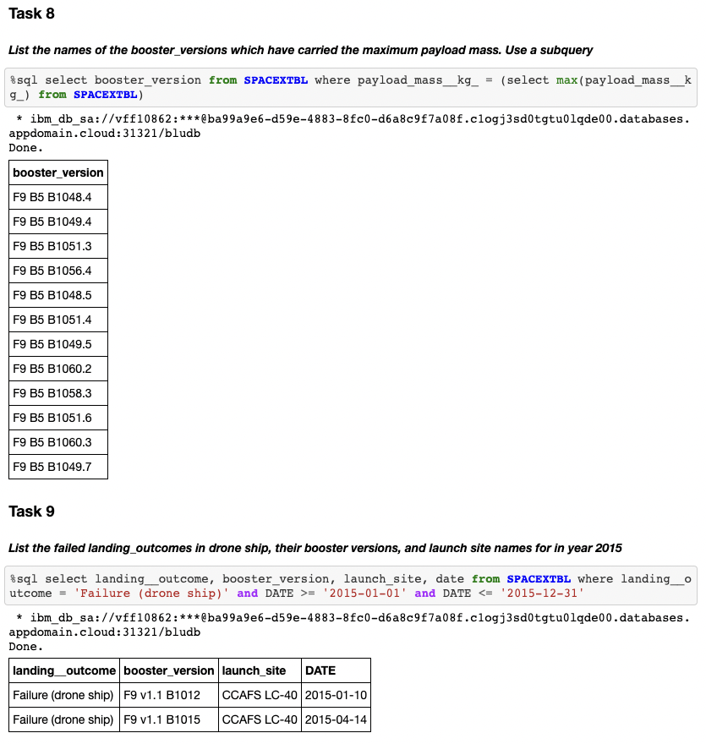
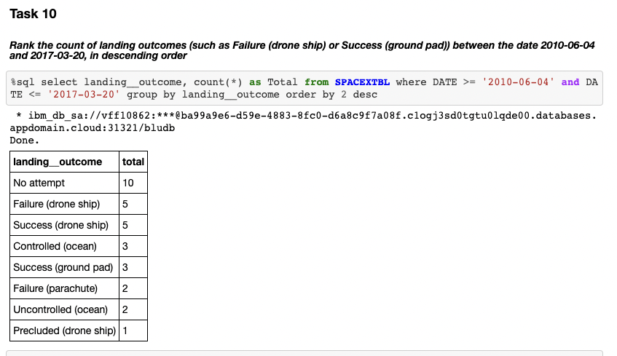
EDA with SQL- here

Slide 23
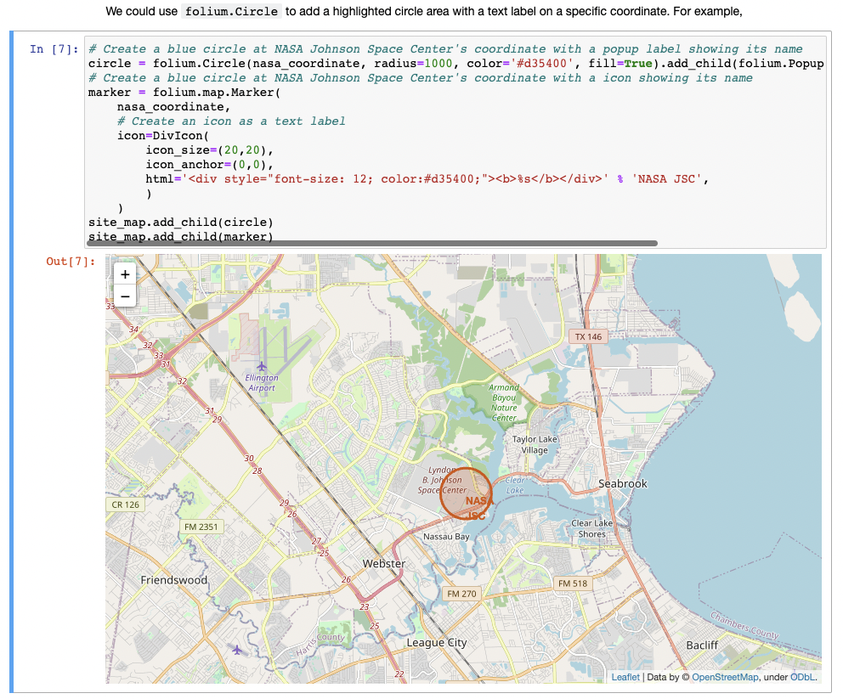
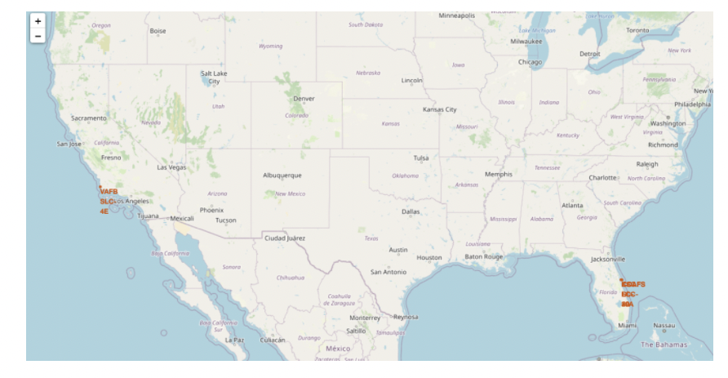
Folium- here

Slide 24
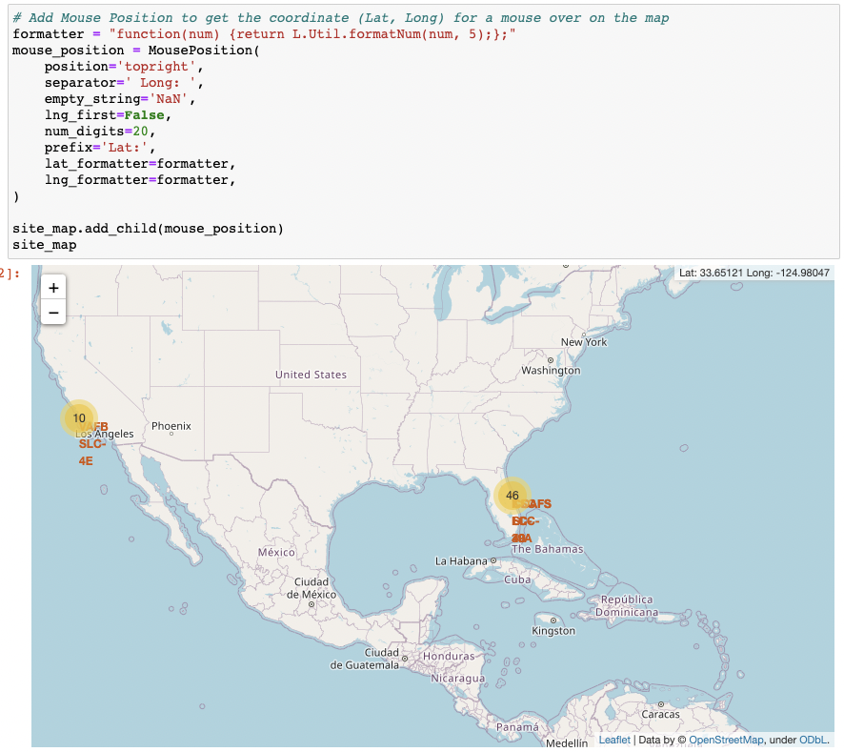
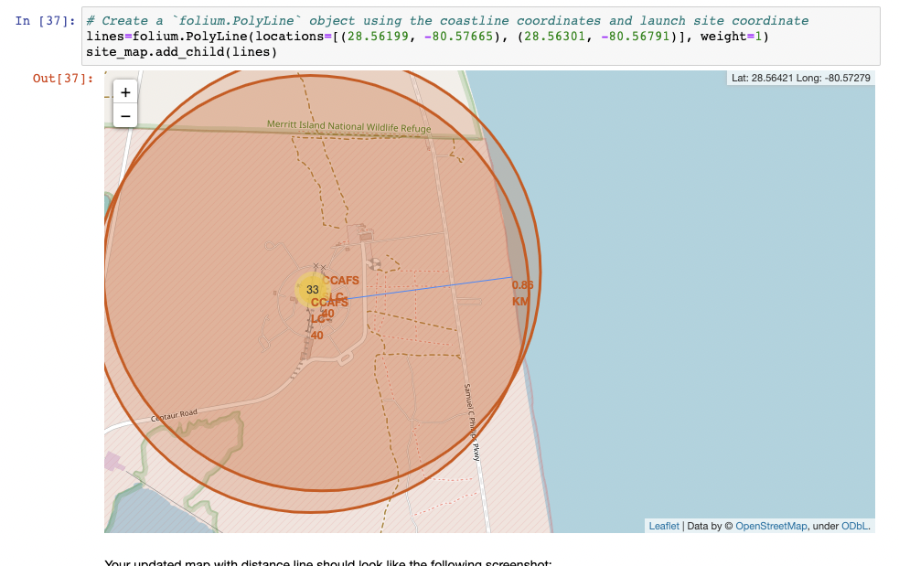
Folium- here

Slide 25
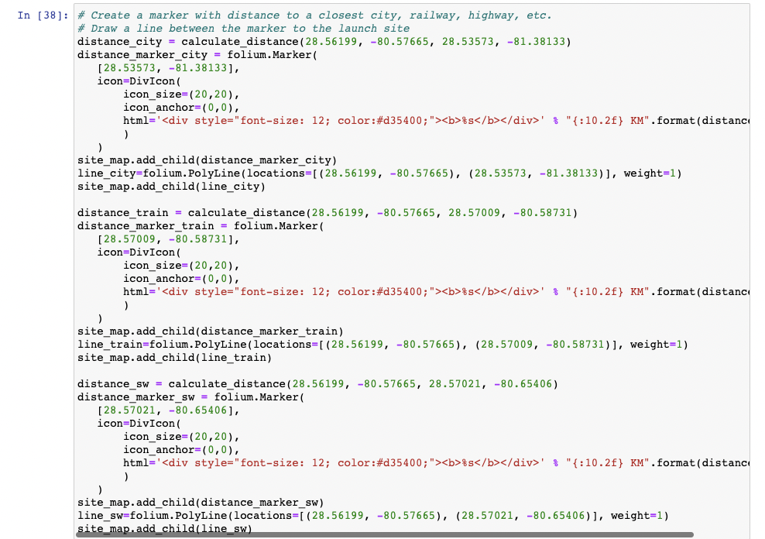
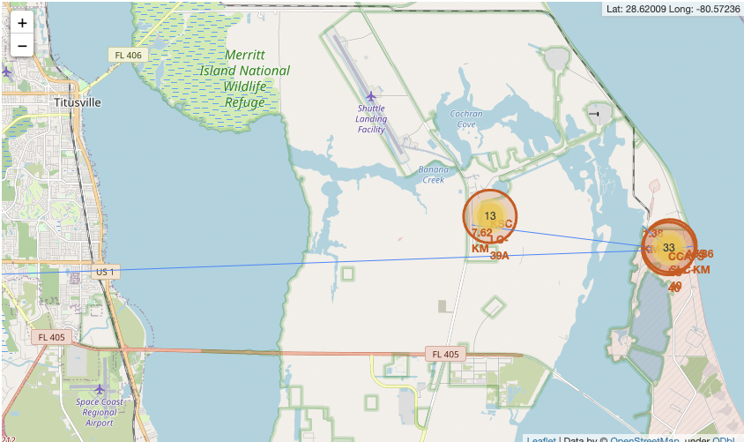
Folium- here

Slide 26
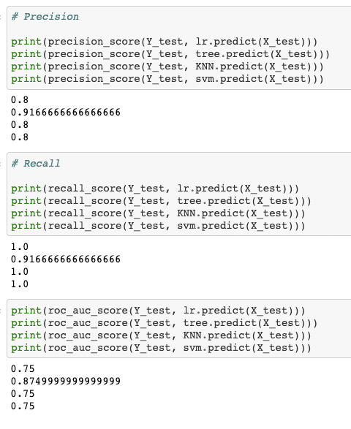
Predictive Analysis - here

